Slide 1
Social Control
By: Carolyn Stoughton, Carolyn Kirshe, Caroline McCloskey, Julia Formicola

Slide 2
Problems
Men drinking and becoming abusive
Prostitution becoming widespread
Limited amount of people taking part in leisure time
Too much people were living in poor neighborhoods

Slide 3
Goals
Ban alcohol
Make prostitution illegal
Censor and decommercialize
“Americanize” kids through education

Slide 4
Exposure/ Muckraking
Temperance
Propaganda used to persuade public (mainly men) to stop drinking
Education
More high schools were built
Better curriculum
Emphases on the importance of getting an eduction

Slide 5
Obstacles Faced
Passing laws against prostitution left, for some woman, a lack of other means of work
Alcohol laws were disliked by the majority and most would go around the laws and disobey them (boot legging)
With the boom of education, there were rising needs for many more teachers

Slide 6
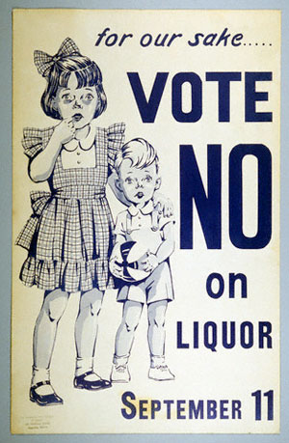
Strategies and Tactics
Temperance
Use of propaganda to justify the 18th amendment
Education
Draw support from middle class
Modernize schools
Express the importance of health education
All contributed to improved school system and laws

Slide 7
Groups And Level of involvement
Women’s Christian Temperance Union (WTCU)
Anti-Saloon Leauge
“Pietists” vs. “Ritualists”
National Board of Censorship
National Education Association
College Entrance Board

Slide 8
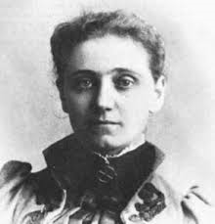
Leaders And Reformers
Francis Galton
Jane Addams
Fredric Howe
Edward Cubberly

Slide 9
Success/Failures
People were exposed to the horrible working conditions in factories (muckrakers)
Woman’s suffrage
Child Labor Laws
Tax Reforms
Control of monopolies
Prohibition was not carried out
Civil Rights

